Slide 1
UNDEFINED
HERE IS WHERE YOUR PRESENTATION BEGINS

Slide 2
TABLE OF CONTENTS
01
03
02
04
OUR TEAM
PROCESS
TECHNOLOGIES
IDEA

Slide 3
01
TEAM

Slide 4
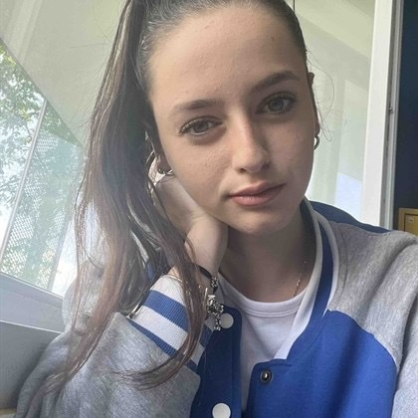
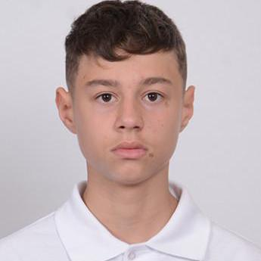
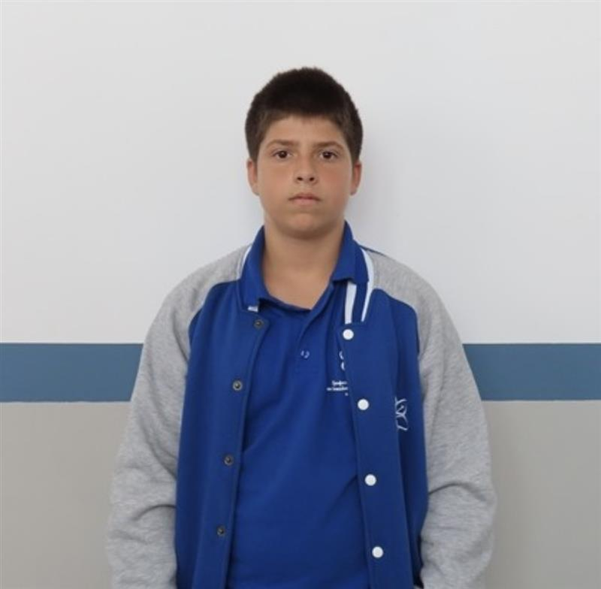
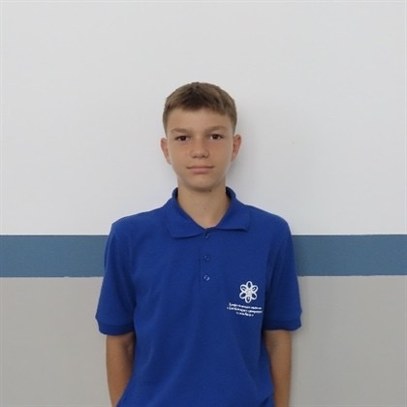
EXPERIENCE
Beloslava Ileva 9B
Kaloyan Pozharliev 9G
Kaloyan Kolev 9A
Petur Stoikov 9V
Back – End Developer
Front – End Developer
Scrum trainer
Designer
MARS
DESPITE BEING RED, MARS IS A COLD PLACE

Slide 5
02
IDEA

Slide 6
Our idea is to create an interactive site that can save lifes. It shows you a map with active incidents, teams and statistic which can be really helpful!

Slide 7
03
Process

Slide 8
OUR PROCESS DURING THE WEEKS WE HAD
 | Week 1 | Week 2 | Week 3 | Week 4
Beloslava
Kaloyan P.
Kaloyan K.
Petur

Slide 9
04
Technologies

Slide 10







Slide 11
Let’s take a look now
FIRE DEPT.

